Slide 1


Log in
Register

Slide 2
User
MayorTest
Pass
*************
Start

Slide 3


User
MayorTest
E-mail
Mayor@whatmail.com
Pass
123456789
Re-Pass
*********
Regis

Slide 4
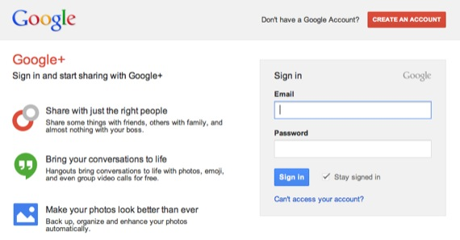

Slide 5
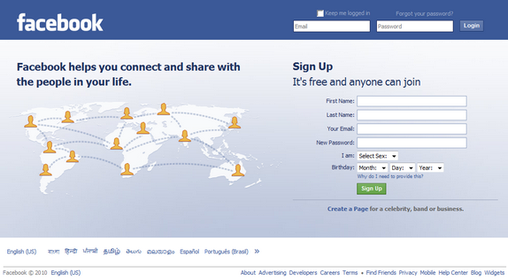

Slide 6
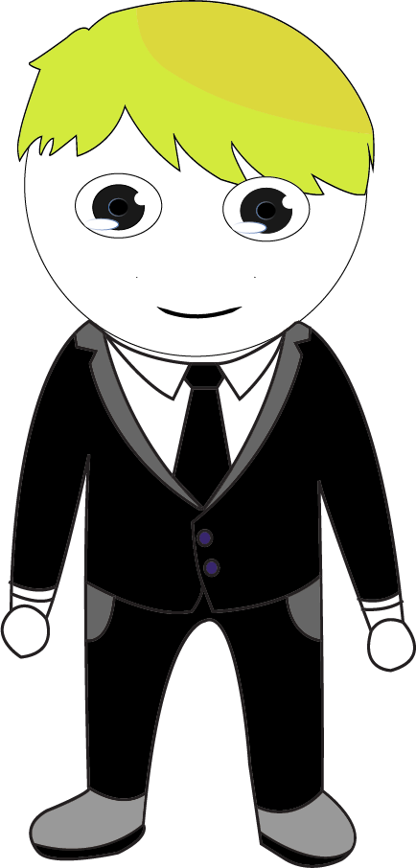
Hair
Shirt
Eyes
Pant
Mouth
Shoes
Face
Else
Start!!

Slide 7





Items
Friends
Shop
Map

Slide 8
List
Bob
Items
Friends
Shop
Map
Items
Friends
Shop
Map

Slide 9

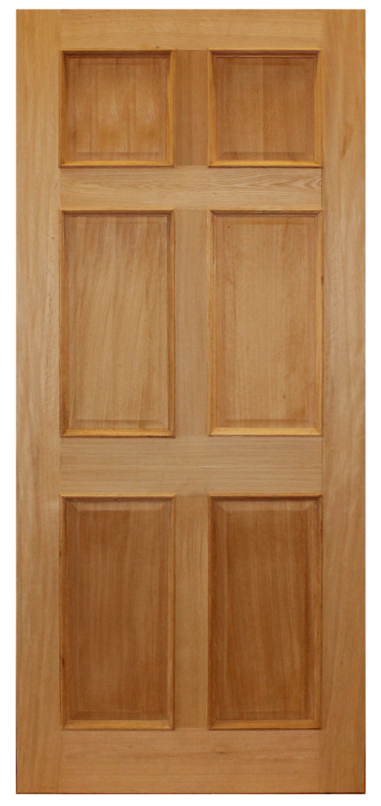
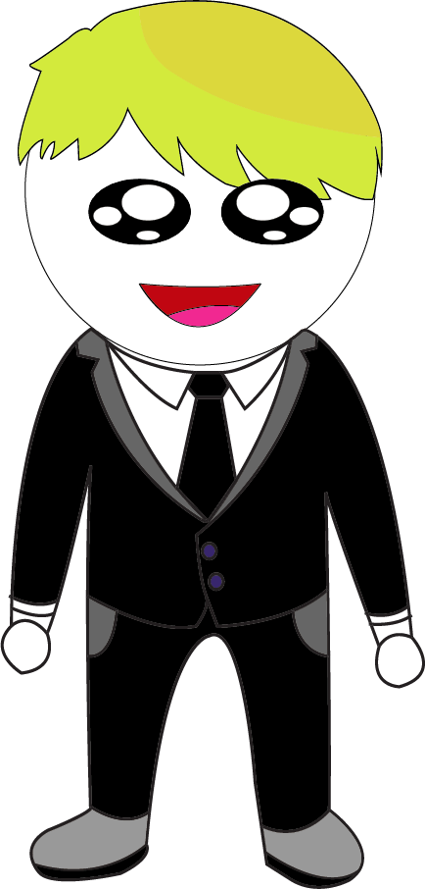
Hi Mayor
Items
Friends
Shop
Map

Slide 10
SOON

Slide 11
List
List

